Slide 1
Soil- Structure Interaction

Slide 2
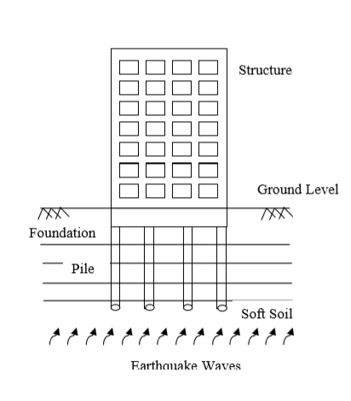
Soil- Structure Interaction
Static SSI
Dynamic SSI
SSI is important for?

Slide 3
Free- Field Motion:
Ground motions that are not influenced by the presence of structure are referred as free field motions.
Structures founded on solid rock has motion which is very close to the free field motion.

Slide 4
Terminology of Local Site Effects
Impedance contrast:
It is the product of velocity and density of the material.
Resonance:
When the signal frequency matches with the fundamental frequency of the soil layer, This results in to tremendous increase in ground motion amplification.
Damping in Soil:
Absorption of energy occurs due to imperfect elastic properties of medium in which the particle of a medium do not react perfectly elastically with their neighbor .

Slide 5

Quality factor (Q) : It is defined as the fractional loss of energy per cycle
where ∆E is the energy lost in one cycle and E is the total elastic energy stored in the wave.

Slide 6
Trapping of Waves:
It results in increase in the duration of ground motion.
Degree of Influence of SSI:
Response of structure depends on the following factors
• Stiffness of soil.
• Dynamic Characteristics of structure.
• Stiffness and mass of structure.

Slide 7
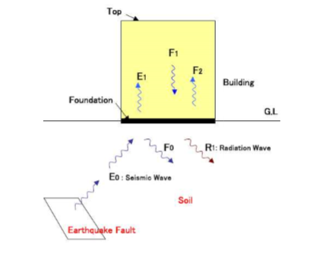
Interaction between Ground and Structure during Earthquake
Seismic wave
Transmission Waves
Reflection Waves

Slide 8
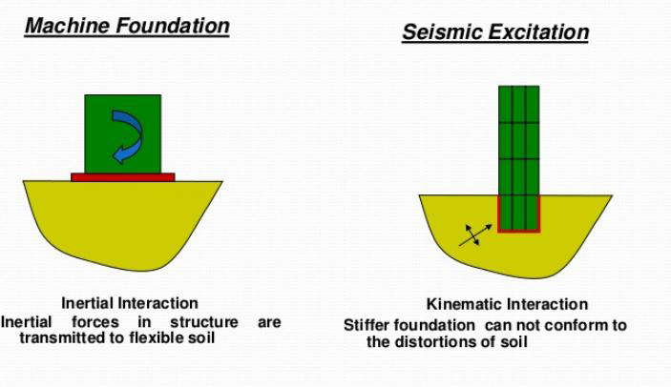
SSI Types

Slide 9
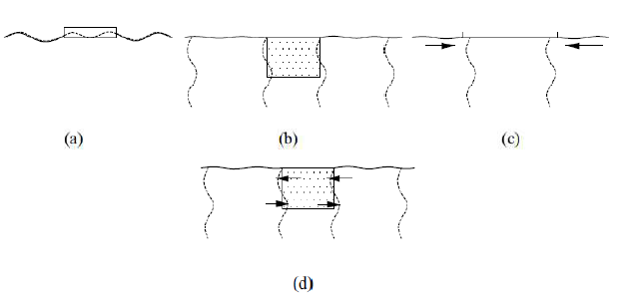
Kinematic Interaction
The SSI effect which is associated with the stiffness of the structure is termed as kinematic interaction.
Kinematic interaction:
(a) vertical motion modified;
(b) horizontal motion modified;
(c) incoherent ground motion prevented; and
(d) rocking motion introduced (Datta, 2010).

Slide 10
Inertial Interaction:
The mass of structure and foundation causes them to respond dynamically.
The SSI effect which is associated with the mass of the structure is termed as inertial interaction.
It is purely caused by the inertia forces generated in the structure due to the movement of masses of the structure during vibration.

Slide 11
Thank you

